Slide 1

Mini Project
Arduino Parking System
SY B.Tech
Course: MAIOT (CET3014B)
By
Dhairya Hindoriya ,03
Rohan Nair.02
Sudhanshu Kale,06
Prajwal Mandavgane,14
Submitted to:- Shamla Mantri
Presentation Date:- 11/5/23

Slide 2
Index
Introduction
Project Description (Block Diagram)
Explanation with circuit diagram
Simulation Results Screenshots
Applications
Conclusion and learning experience
References

Slide 3
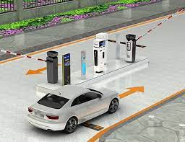
Introduction
The Arduino parking system with IR proximity sensor is a device designed to aid drivers in parking their vehicles. It uses an IR proximity sensor to detect the distance between the vehicle and obstacles, a servo motor to control the movement of the sensor, and a 16x2 LCD i2c display to show the distance measurement. This report will cover the working principle, components used, and the implementation of the Arduino parking system with IR proximity sensor

Slide 4
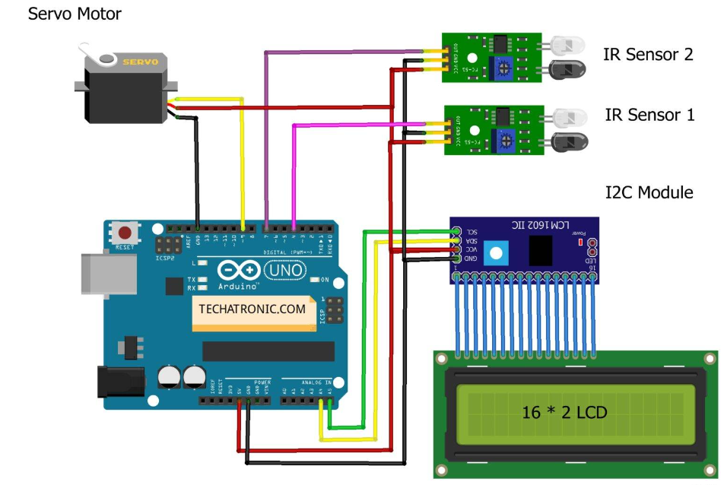
Project Description (Circuit Diagram)

Slide 5
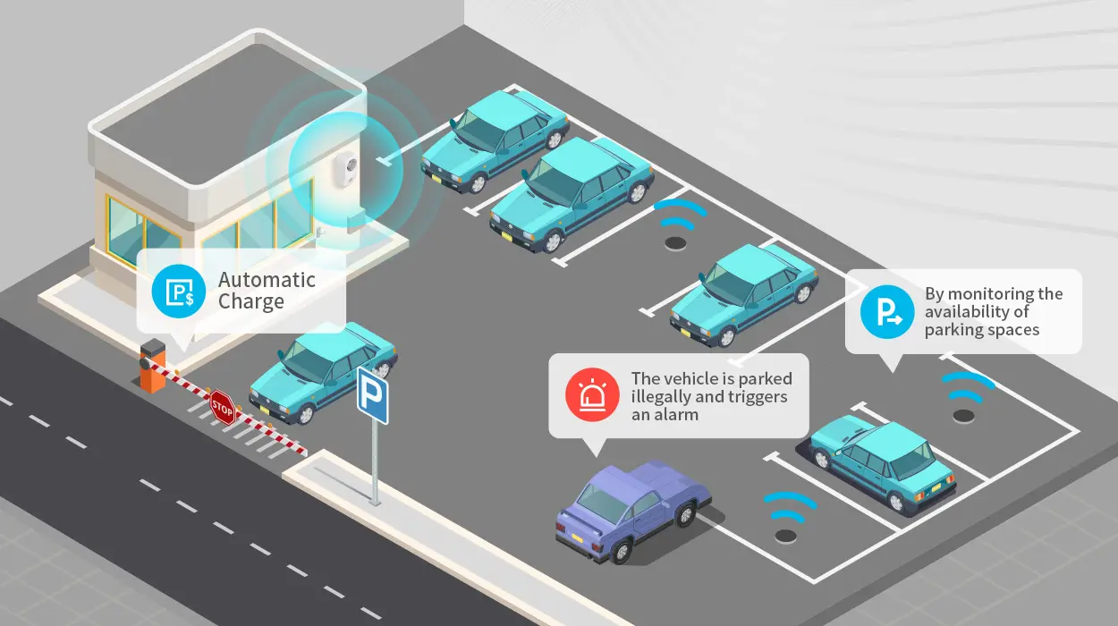
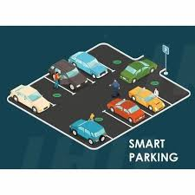
Explanation with circuit diagram
The IR proximity sensor emits infrared radiation that bounces off nearby objects and returns to the sensor. By measuring the time taken for the signal to return, the sensor can determine the distance to the object. The Arduino UNO board processes this information and sends a signal to the servo motor to move the sensor accordingly. The servo motor is responsible for controlling the position of the IR sensor, allowing it to scan the area in front of the vehicle. The distance measurement is displayed on the 16x2 LCD i2c display.

Slide 6
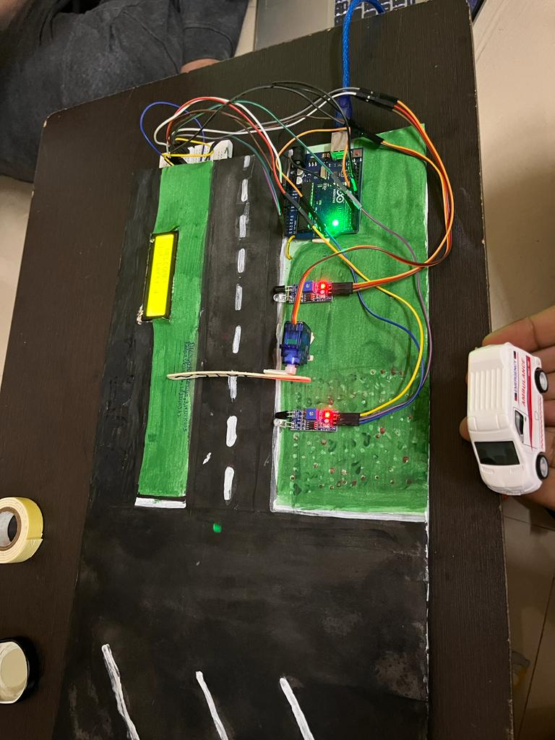
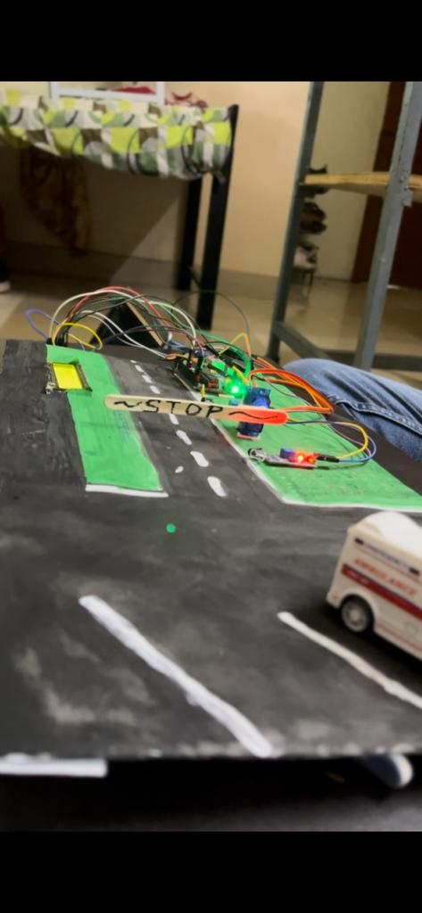
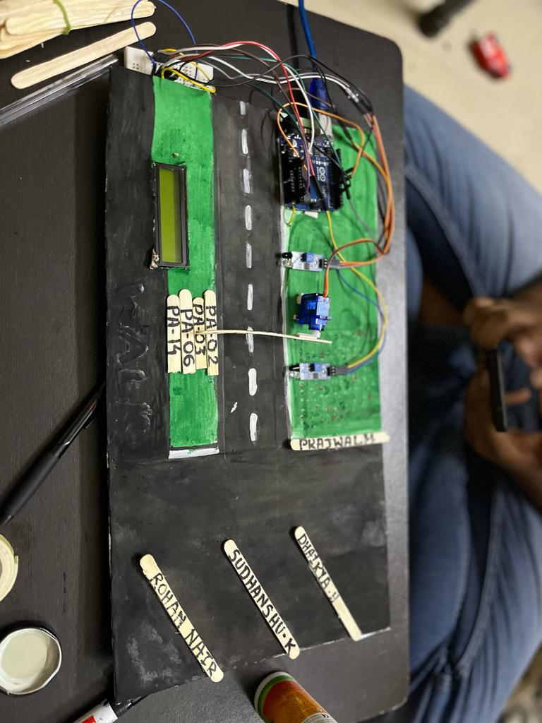
Results Screenshots

Slide 7
Applications
Smart Parking Lot: Implementing an Arduino parking system can turn a conventional parking lot into a smart parking lot. Users can easily find available parking spaces without the need to drive around searching for one.
Parking Garages: Arduino parking systems can be used in multi-level parking garages to monitor the availability of parking spaces on each level. LED indicators or signage can guide drivers to vacant spots.
Smart Cities: In smart city initiatives, Arduino parking systems can be integrated into a centralized monitoring system. This allows authorities to manage parking resources efficiently, gather data on parking utilization, and optimize traffic flow.
Shopping Centers: Arduino parking systems can be installed in shopping centers to help shoppers locate available parking spaces quickly. Real-time data can be displayed on LCD screens at entrance points or integrated into mobile apps.
Airports and Train Stations: Busy transportation hubs can benefit from Arduino parking systems by providing real-time parking information to travelers. LED displays or mobile apps can guide them to vacant spots and reduce congestion.

Slide 8
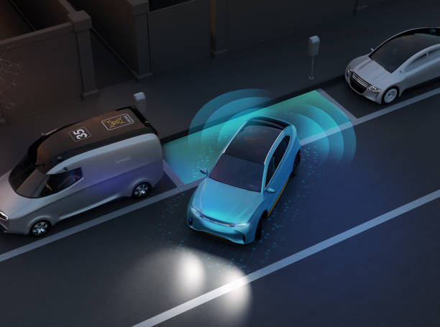
Conclusion
The Arduino parking system with IR proximity sensor is an effective way to help drivers park their vehicles safely. The system uses an IR proximity sensor to detect the distance between the vehicle and obstacles, a servo motor to control the movement of the sensor, and a 16x2 LCD i2c display to show the distance measurement. The system is easy to implement and can be a useful addition to any vehicle.

Slide 9
References
M Sodiq1 and H Hasbullah1:-
IOP Conference Series: Materials Science and Engineering, Volume 384, International Symposium on Materials and Electrical Engineering (ISMEE) 2017 16 November 2017, Bandung, Indonesia
Z. M. T. Kabir, N. D. Nath, F. Hasan, R. A. Utshaw and L. Saha”:-
"Automated Parking System with Fee Management Using Arduino," 2019 10th International Conference on Computing, Communication and Networking Technologies (ICCCNT), Kanpur, India, 2019, pp. 1-6, doi: 10.1109/ICCCNT45670.2019.8944642
M. Kannan, L. William Mary, C. Priya and R. Manikandan:-
"Towards Smart City through Virtualized and Computerized Car parking System using Arduino in the Internet of Things," 2020 International Conference on Computer Science, Engineering and Applications (ICCSEA), Gunupur, India, 2020, pp. 1-6, doi: 10.1109/ICCSEA49143.2020.9132876.

